Slide 1
Airline Dashboard
File created on: 5/31/2023 5:22:54 PM

Slide 2
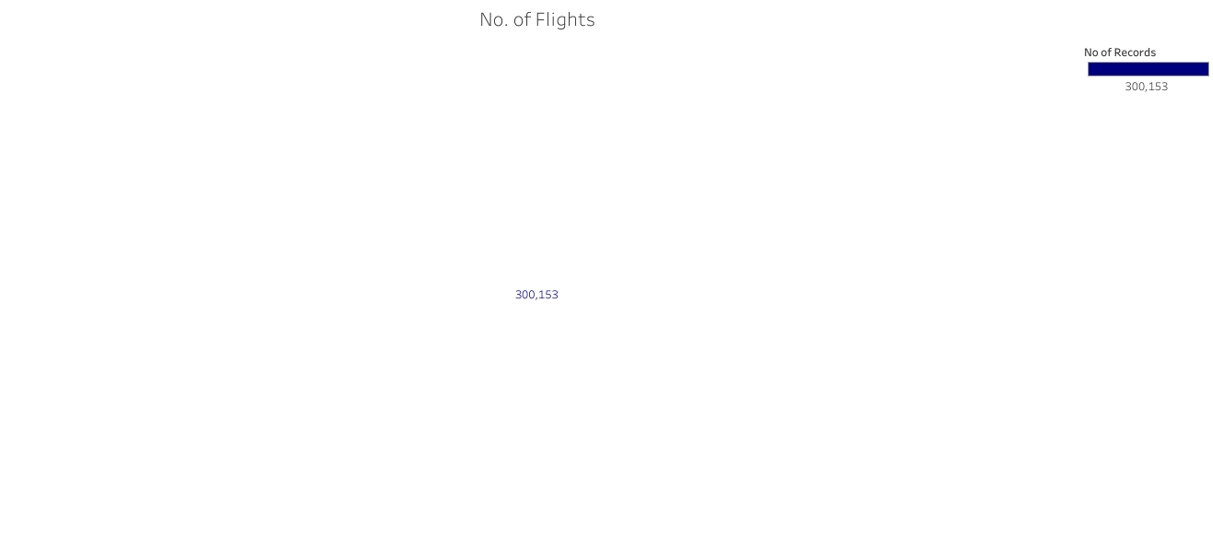

Slide 3
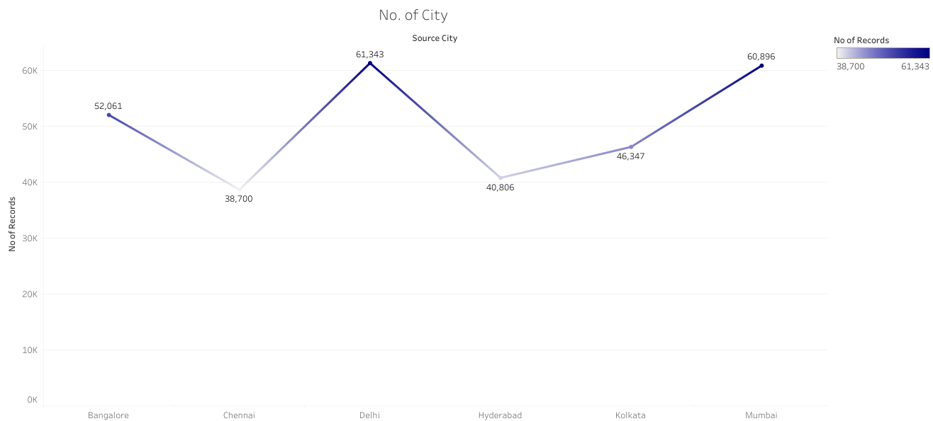

Slide 4
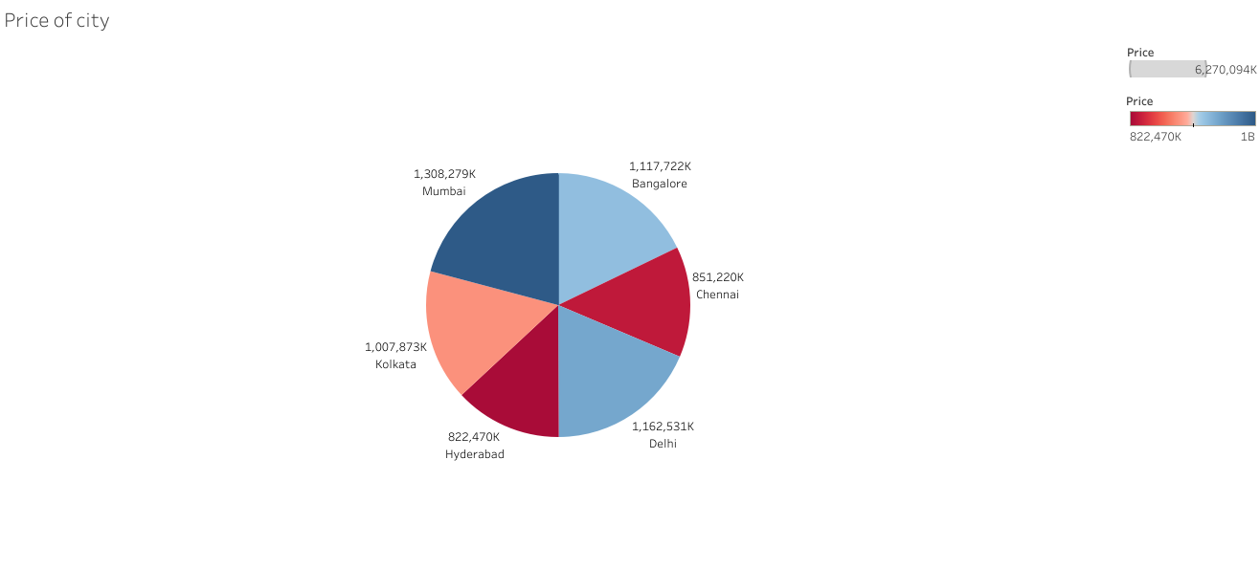

Slide 5
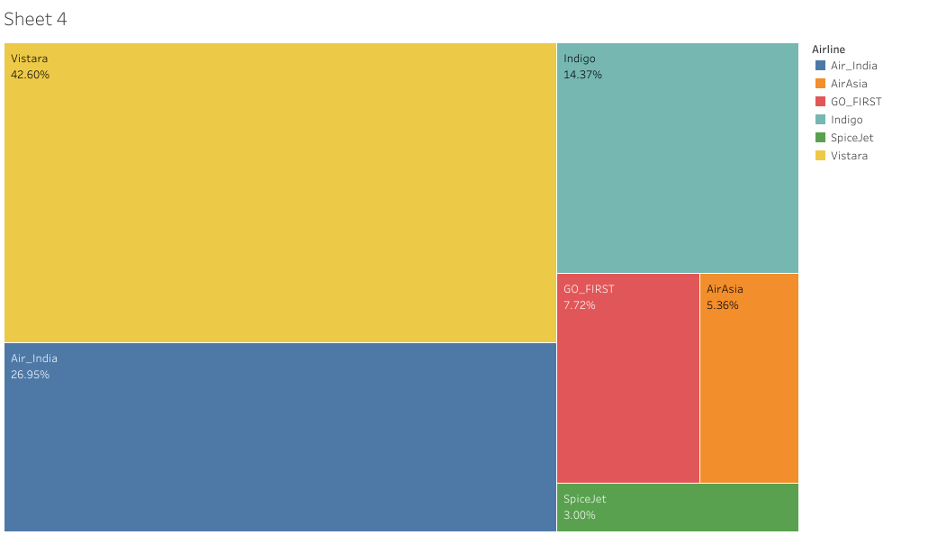

Slide 6
